Slide 1

About the Presentations
The presentations cover the objectives found in the opening of each chapter.
All chapter objectives are listed in the beginning of each presentation.
You may customize the presentations to fit your class needs.
Some figures from the chapters are included. A complete set of images from the book can be found on the Instructor Resources disc.

Slide 2
Oracle 11g: SQL
Chapter 8
Restricting Rows and Sorting Data

Slide 3
Objectives
Use a WHERE clause to restrict the rows returned by a query
Create a search condition using mathematical comparison operators
Use the BETWEEN…AND comparison operator to identify records within a range of values
Specify a list of values for a search condition using the IN comparison operator
Oracle 11g: SQL

Slide 4
Objectives (continued)
Search for patterns using the LIKE comparison operator
Identify the purpose of the % and _ wildcard characters
Join multiple search conditions using the appropriate logical operator
Perform searches for NULL values
Specify the order for the presentation of query results using an ORDER BY clause
Oracle 11g: SQL

Slide 5
WHERE Clause Syntax
A WHERE clause is used to retrieve rows based on a stated condition
Requires:
  Column name
  Comparison operator
  Value or column for comparison
Values are case sensitive
Oracle 11g: SQL

Slide 6
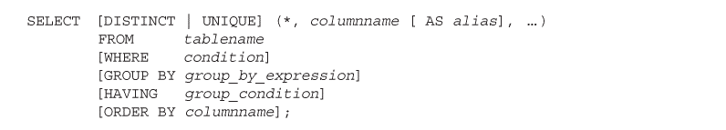
Oracle 11g

Slide 7
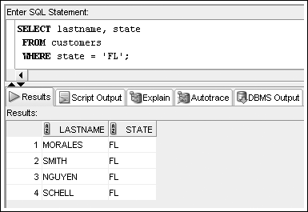
WHERE Clause Example
List WHERE clause after FROM clause
Enclose nonnumeric data in single quotes
Oracle 11g: SQL

Slide 8
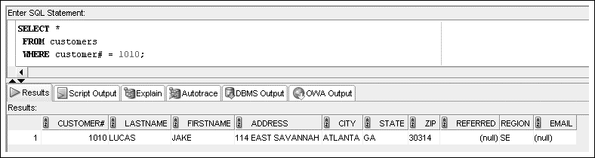
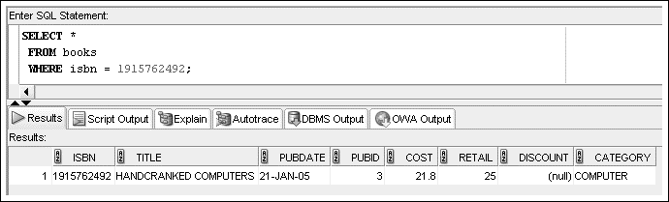
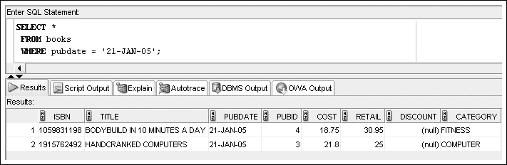
Oracle 11g

Slide 9
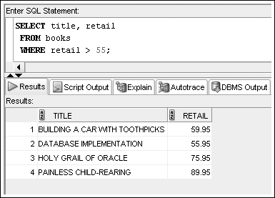
Comparison Operators
Indicate how the data should relate to the given search value
Oracle 11g: SQL

Slide 10
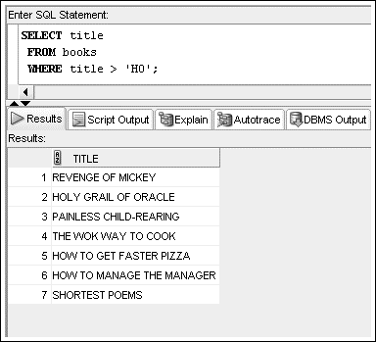
Oracle 11g

Slide 11
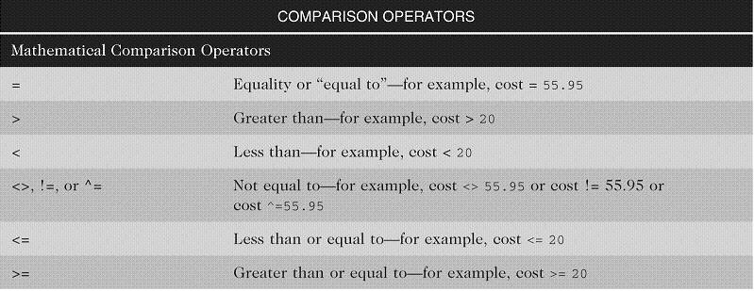
Arithmetic Comparison Operators
Oracle 11g: SQL

Slide 12
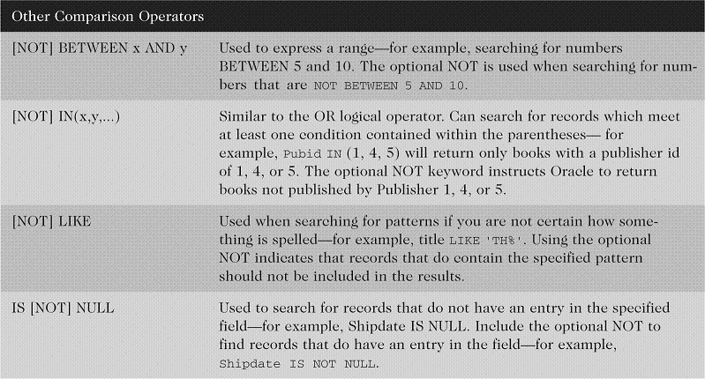
Other Comparison Operators
Oracle 11g: SQL

Slide 13
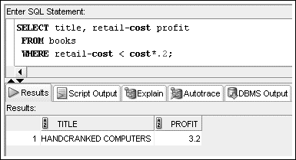
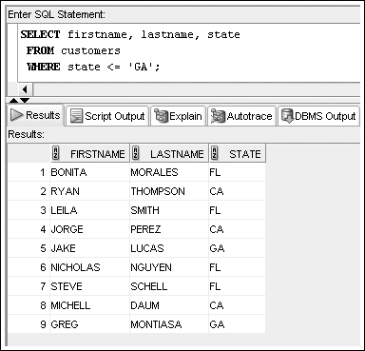
Oracle 11g

Slide 14
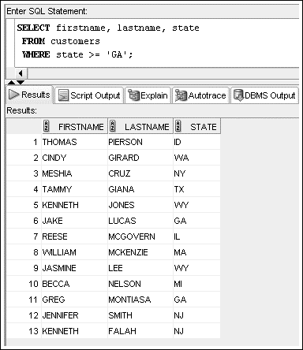
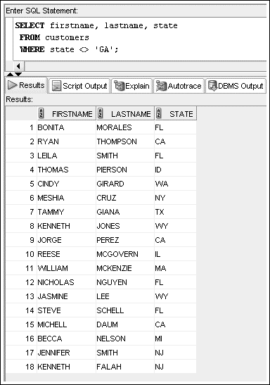
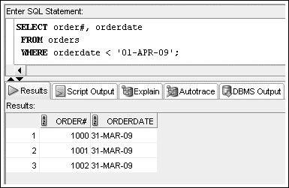
Oracle 11g

Slide 15
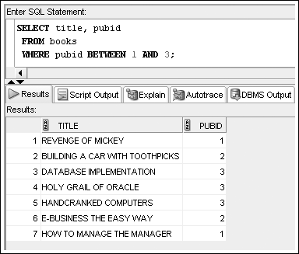
BETWEEN…AND Operator
Finds values in a specified range
Oracle 11g: SQL

Slide 16
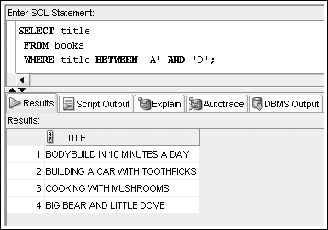
Oracle 11g

Slide 17
IN Operator
Returns records that match a value in a specified list
List must be in parentheses
Values are separated by commas
Oracle 11g: SQL

Slide 18
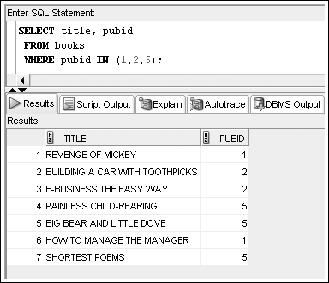
IN Operator Example
Oracle 11g: SQL

Slide 19
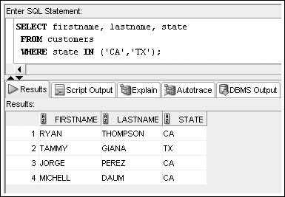
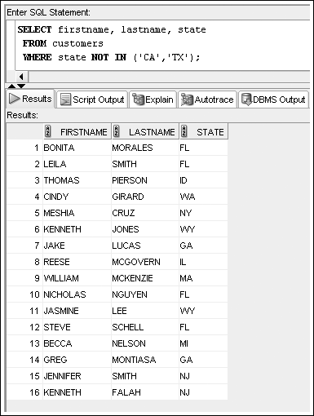
Oracle 11g

Slide 20
LIKE Operator
Performs pattern searches
Used with wildcard characters
  Underscore (_) for exactly one character in the indicated position
  Percent sign (%) represents any number of characters
Oracle 11g: SQL

Slide 21
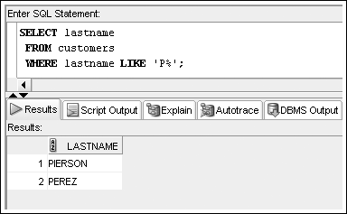
LIKE Operator Example
Oracle 11g: SQL

Slide 22
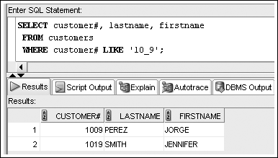
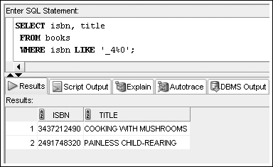
Oracle 11g

Slide 23
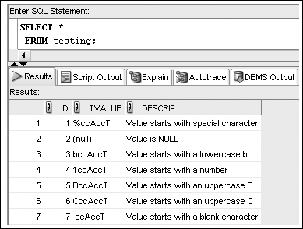
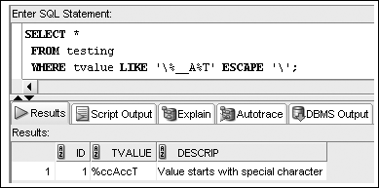
Oracle 11g

Slide 24
Logical Operators
Used to combine conditions
Evaluated in order of NOT, AND, OR
  NOT – reverses meaning
  AND – both conditions must be TRUE
  OR – at least one condition must be TRUE
Oracle 11g: SQL

Slide 25
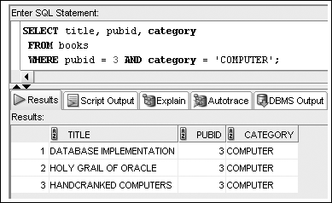
AND Logical Operator Example
Oracle 11g: SQL

Slide 26
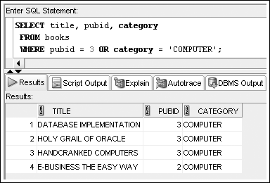
OR Logical Operator Example
Oracle 11g: SQL

Slide 27
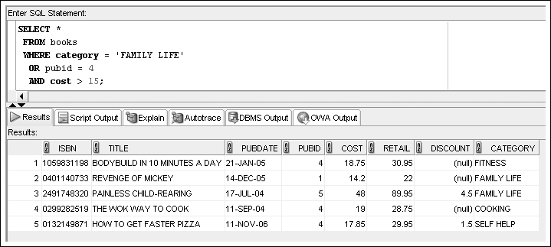
Multiple Logical Operators
Resolved in order of NOT, AND, OR
Oracle 11g: SQL

Slide 28
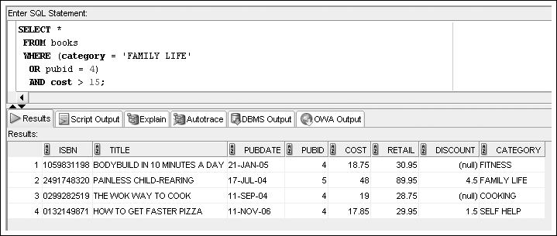
Multiple Logical Operators
Use parentheses to override the order of evaluation
Oracle 11g: SQL

Slide 29
Resolving Multiple Types of Operators
Arithmetic operators
Comparison operators
Logical operators
Oracle 11g: SQL

Slide 30
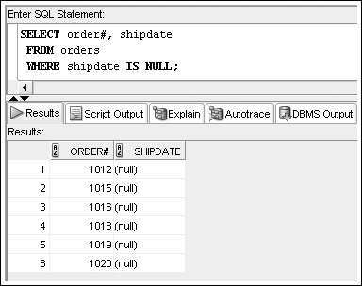
Treatment of NULL Values
Absence of data
Requires use of IS NULL operator
Oracle 11g: SQL

Slide 31
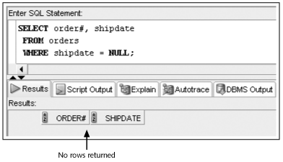
Treatment of NULL Values (continued)
A common error is using = NULL, which does not raise an Oracle error but also does not return any rows
Oracle 11g: SQL

Slide 32
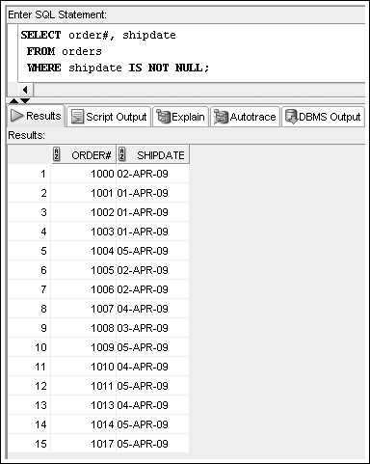
Oracle 11g

Slide 33

ORDER BY Clause Syntax
The ORDER BY clause presents data in sorted order
Ascending order is default
Use DESC keyword to override column default
255 columns maximum
Oracle 11g: SQL

Slide 34
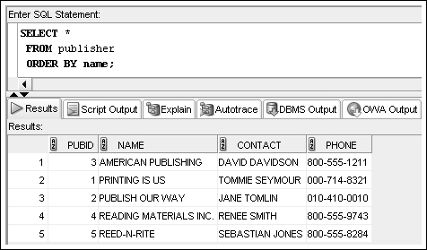
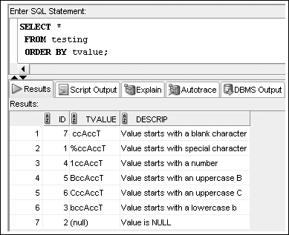
Oracle 11g

Slide 35
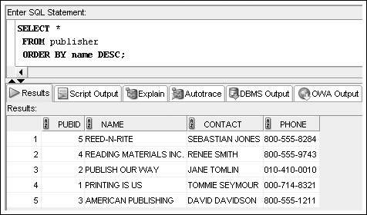
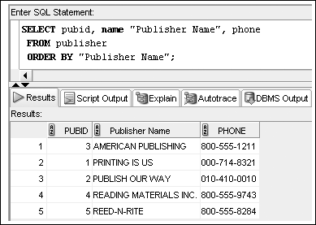
Oracle 11g

Slide 36
ORDER BY Clause Syntax
Sort Sequence
In ascending order, values will be listed in the following sequence:
  Numeric values
  Character values
  NULL values
In descending order, sequence is reversed
Oracle 11g: SQL

Slide 37
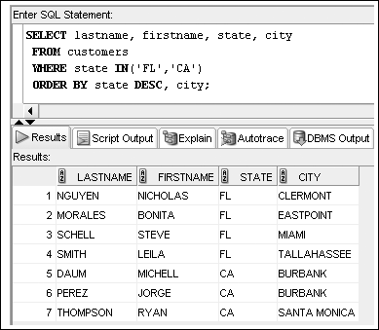
ORDER BY Example
Oracle 11g: SQL

Slide 38
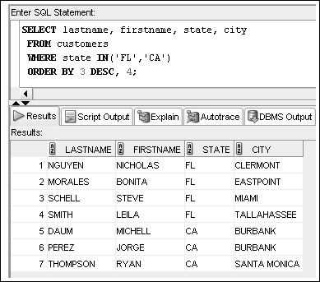
ORDER BY Can Reference
Column Position
Oracle 11g: SQL

Slide 39
Summary
The WHERE clause can be included in a SELECT statement to restrict the rows returned by a query to only those meeting a specified condition
When searching a nonnumeric field, the search values must be enclosed in single quotation marks
Comparison operators are used to indicate how the record should relate to the search value
The BETWEEN...AND comparison operator is used to search for records that fall within a certain range of values
Oracle 11g: SQL

Slide 40
Summary (continued)
The LIKE comparison operator is used with the percent and underscore symbols (% and _) to establish search patterns
Logical operators such as AND and OR can be used to combine several search conditions
When using the AND operator, all conditions must be TRUE for a record to be returned in the results
  However, with the OR operator, only one condition must be TRUE
A NULL value is the absence of data, not a field with a blank space entered
Oracle 11g: SQL

Slide 41
Summary (continued)
Use the IS NULL comparison operator to match NULL values; the IS NOT NULL comparison operator finds records that do not contain NULL values in the indicated column
You can sort the results of queries by using an ORDER BY clause; when used, the ORDER BY clause should be listed last in the SELECT statement
By default, records are sorted in ascending order; entering DESC directly after the column name sorts the records in descending order
A column does not have to be listed in the SELECT clause to serve as a basis for sorting
Oracle 11g: SQL

